Slide 1

8th Grade Math: Pre-Algebra
Unit 2, Lesson 5 Approximating Irrational Numbers Volume 1, pg. 62

Slide 2


Benchmarks
MA.8.NSO.1.1
Extend previous understanding of rational numbers to define irrational numbers within the real number system. Locate an approximate value of a numerical expression involving irrational numbers on a number line.
MA.8.NSO.1.2
Plot, order, and compare rational and irrational numbers represented in various forms.
volume 1, pg. 62

Slide 3
Integrated Mathematical Thinking and Reasoning Standards
MA.K12.MTR.3.1 Complete tasks with mathematical fluency.
MA.K12.MTR.5.1 Use patterns and structure to help understand and connect mathematical concepts.
volume 1, pg. 62

Slide 4

Learning Targets
I can identify whether a number is rational or irrational.
I can approximate the values of irrational numbers.
I can plot irrational numbers on a number line.
volume 1, pg. 62

Slide 5

Warm-Up
volume 1, pg. 63

Slide 6
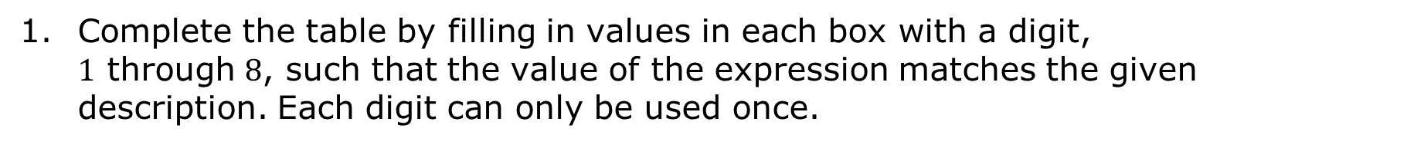
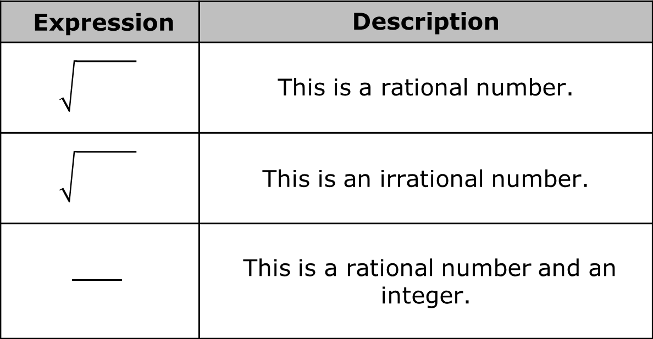
2.5.1 Warm-Up: Rational vs. Irrational
Complete the table by filling in values in each box with a digit, $1$ through $8$, such that the value of the expression matches the given description. Each digit can only be used once.
Expression | Description
 | This is a rational number.
 | This is an irrational number.
 | This is a rational number and an integer.
volume 1, pg. 63

Slide 7
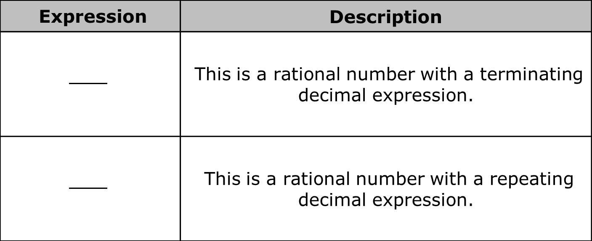
Expression | Description
 | This is a rational number with a terminating decimal expression.
 | This is a rational number with a repeating decimal expression.
volume 1, pg. 63

Slide 8

Collaboration
volume 1, pg. 63

Slide 9


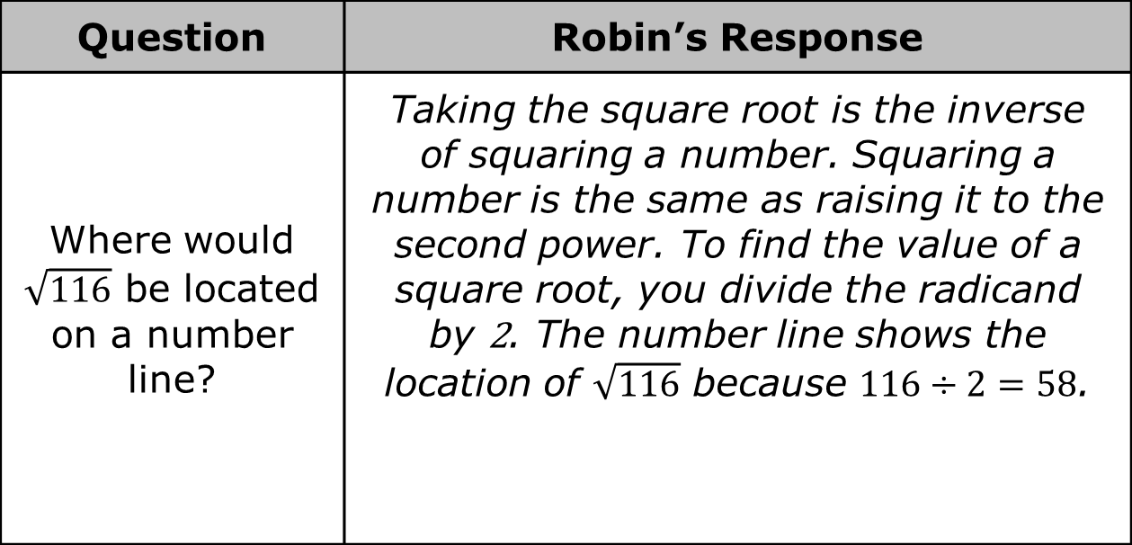

2.5.2 Collaboration: Error Analysis
Robin is learning about square roots. A question and her response are shown in the table. Since this is new for Robin, there are some mistakes in her response.
Question | Robin’s Response
Where would $\sqrt{116}$ be located on a number line? | Taking the square root is the inverse of squaring a number. Squaring a number is the same as raising it to the second power. To find the value of a square root, you divide the radicand by 2. The number line shows the location of $\sqrt{116}$ because $116÷2=58$.
$$\sqrt{116}$$
volume 1, pg. 63

Slide 10
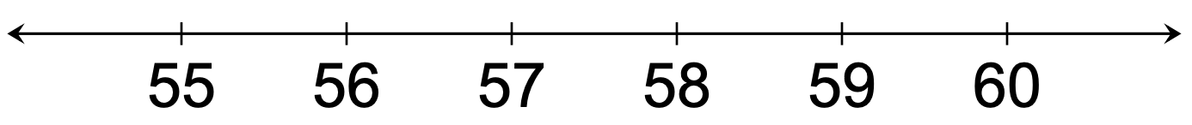
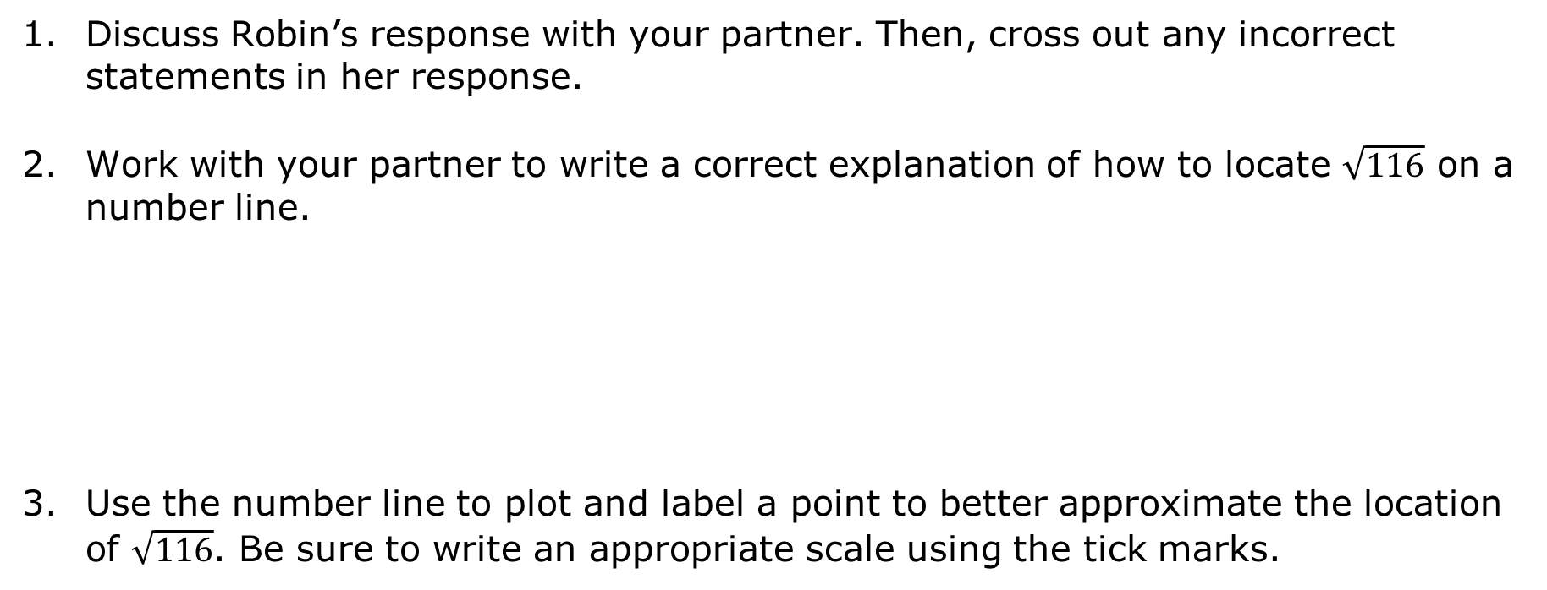
Discuss Robin’s response with your partner. Then, cross out any incorrect statements in her response.
Work with your partner to write a correct explanation of how to locate $\sqrt{116}$ on a number line.
Use the number line to plot and label a point to better approximate the location of $\sqrt{116}$. Be sure to write an appropriate scale using the tick marks.
volume 1, pg. 63

Slide 11

Guided Instruction
volume 1, pg. 64

Slide 12



2.5.3 Guided Instruction: Rational and Irrational Numbers
The real number system includes both rational and irrational numbers.
Rational numbers can be written as a fraction, $\frac{a}{b}$, where $a$ and $b$ are integers and $b≠0$, or as a decimal. In decimal form, rational numbers either terminate or repeat.
When expressed as decimals, irrational numbers do not terminate or repeat. Therefore, any decimal expansion is only an approximate value.
A rational number is a real number that can be expressed as a ratio of two integers.
An irrational number is a real number that cannot be expressed as a ratio of two integers.
volume 1, pg. 64

Slide 13
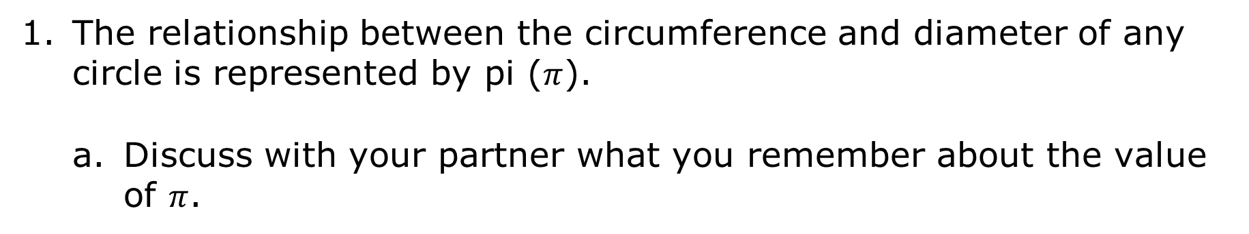
The relationship between the circumference and diameter of any circle is represented by pi ($π$).
Discuss with your partner what you remember about the value of $π$.
volume 1, pg. 64

Slide 14
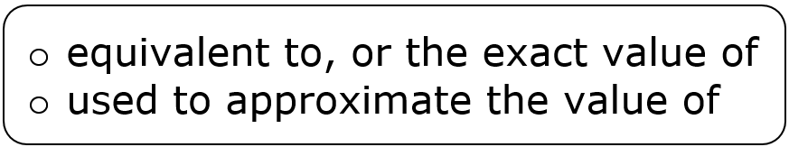
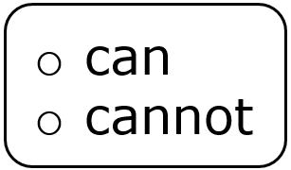
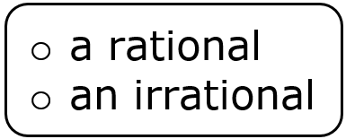
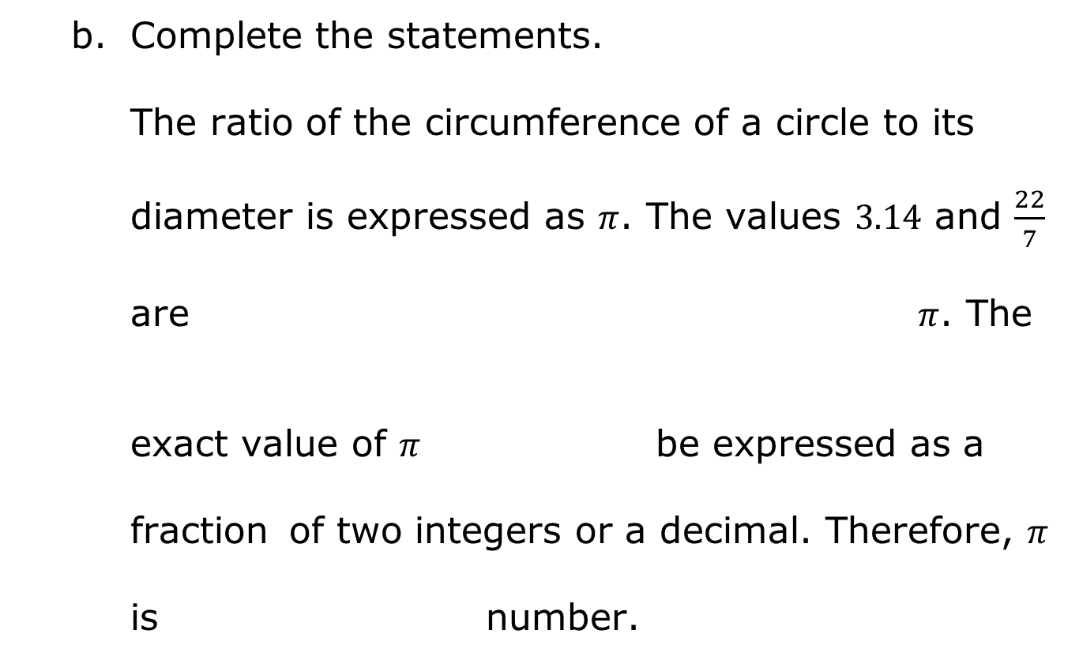
Complete the statements.
The ratio of the circumference of a circle to its
diameter is expressed as $π$. The values $3.14$ and $\frac{22}{7}$
are $π$. The
exact value of $π$ be expressed as a
fraction of two integers or a decimal. Therefore, $π$
is number.
volume 1, pg. 64

Slide 15
Enter each of the following values into a calculator.
Circle the values that can be expressed as a ratio of two integers.
Discuss with your partner how you would describe the values that are not circled.
$$\sqrt{25}$$ | $$\sqrt{18}$$ | $$\sqrt[3]{27}$$ | $$\sqrt[3]{30}$$
volume 1, pg. 65

Slide 16
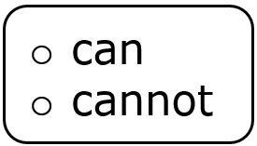
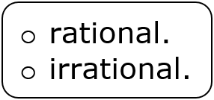
Complete the statements.
Square roots of perfect squares and cube
roots of perfect cubes be expressed
as a ratio of two integers. Therefore, they are
Square roots of non-perfect squares
and cube roots of non-perfect cubes
be expressed as a ratio of two integers. Therefore,
they are
volume 1, pg. 65

Slide 17
Collaboration
volume 1, pg. 65

Slide 18
2.5.4 Collaboration: Rational or Irrational?
Work with your partner to complete the following.
Several numbers are given:
Write each expression in the appropriate column of the table based on the definitions of rational and irrational numbers.
$−\frac{4}{5}$ $\frac{π}{3}$ $5.124784…$ $4.\overline{35}$ $3.275$ $−\sqrt{40}$ $\sqrt[3]{−27}$
Rational | Irrational
volume 1, pg. 65

Slide 19
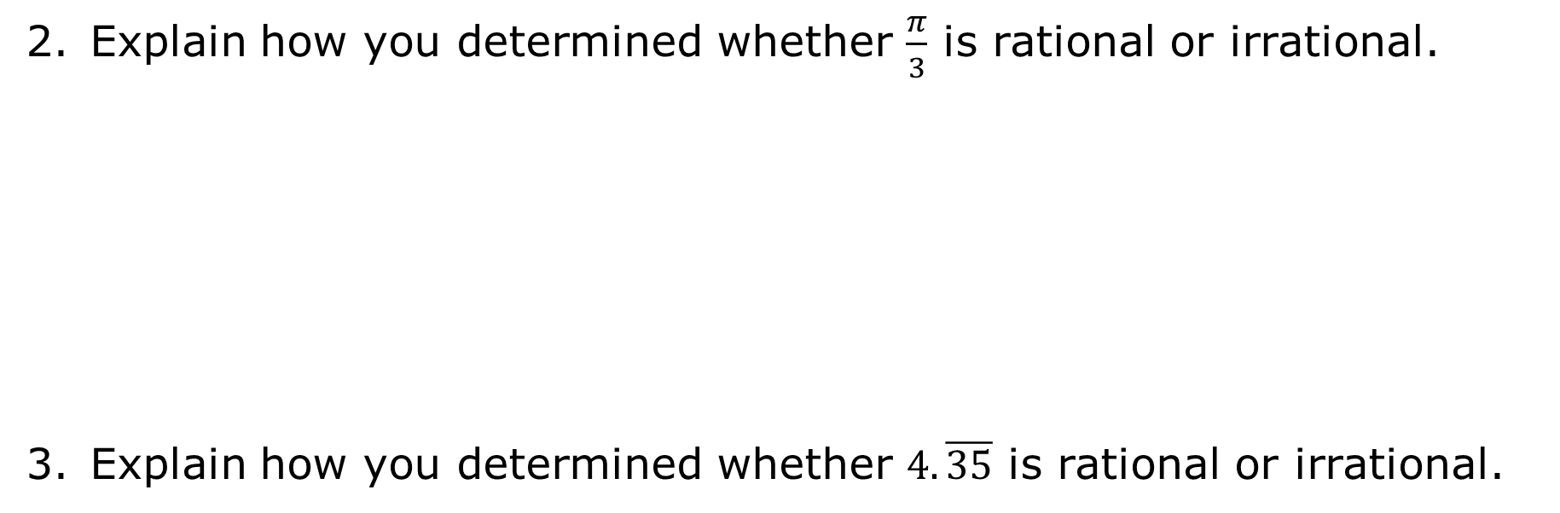
Explain how you determined whether $\frac{π}{3}$ is rational or irrational.
Explain how you determined whether $4.\overline{35}$ is rational or irrational.
volume 1, pg. 66

Slide 20
Guided Instruction
volume 1, pg. 66

Slide 21
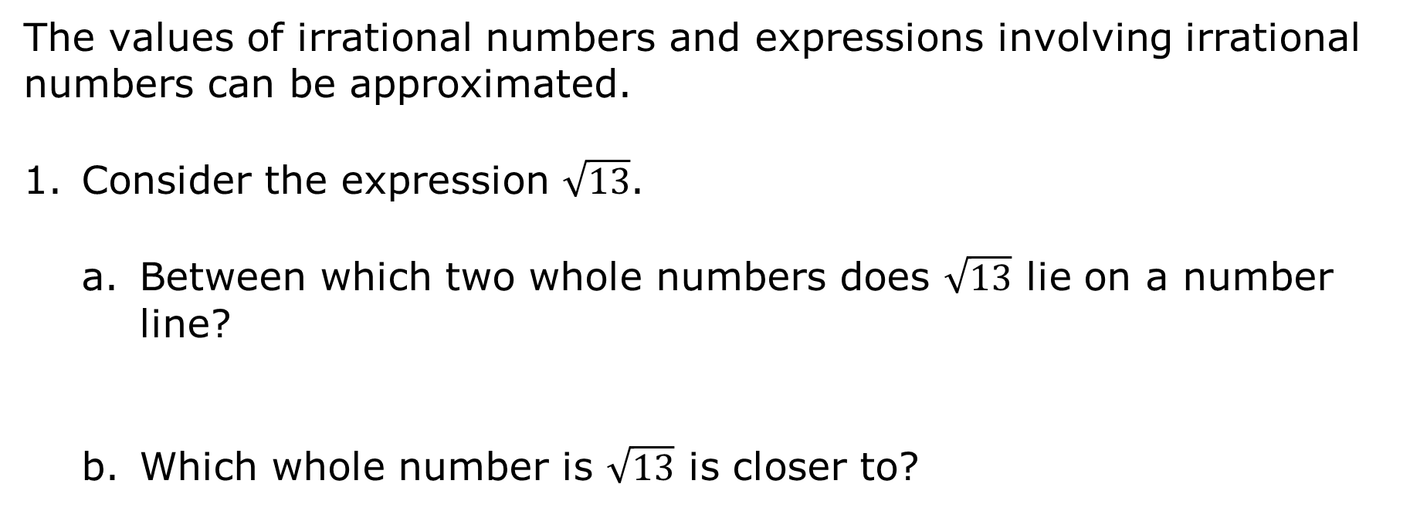
2.5.5 Guided Instruction: Approximating Irrational Numbers and Locating Them on a Number Line
The values of irrational numbers and expressions involving irrational numbers can be approximated.
Consider the expression $\sqrt{13}$.
Between which two whole numbers does $\sqrt{13}$ lie on a number line?
Which whole number is $\sqrt{13}$ is closer to?
volume 1, pg. 66

Slide 22
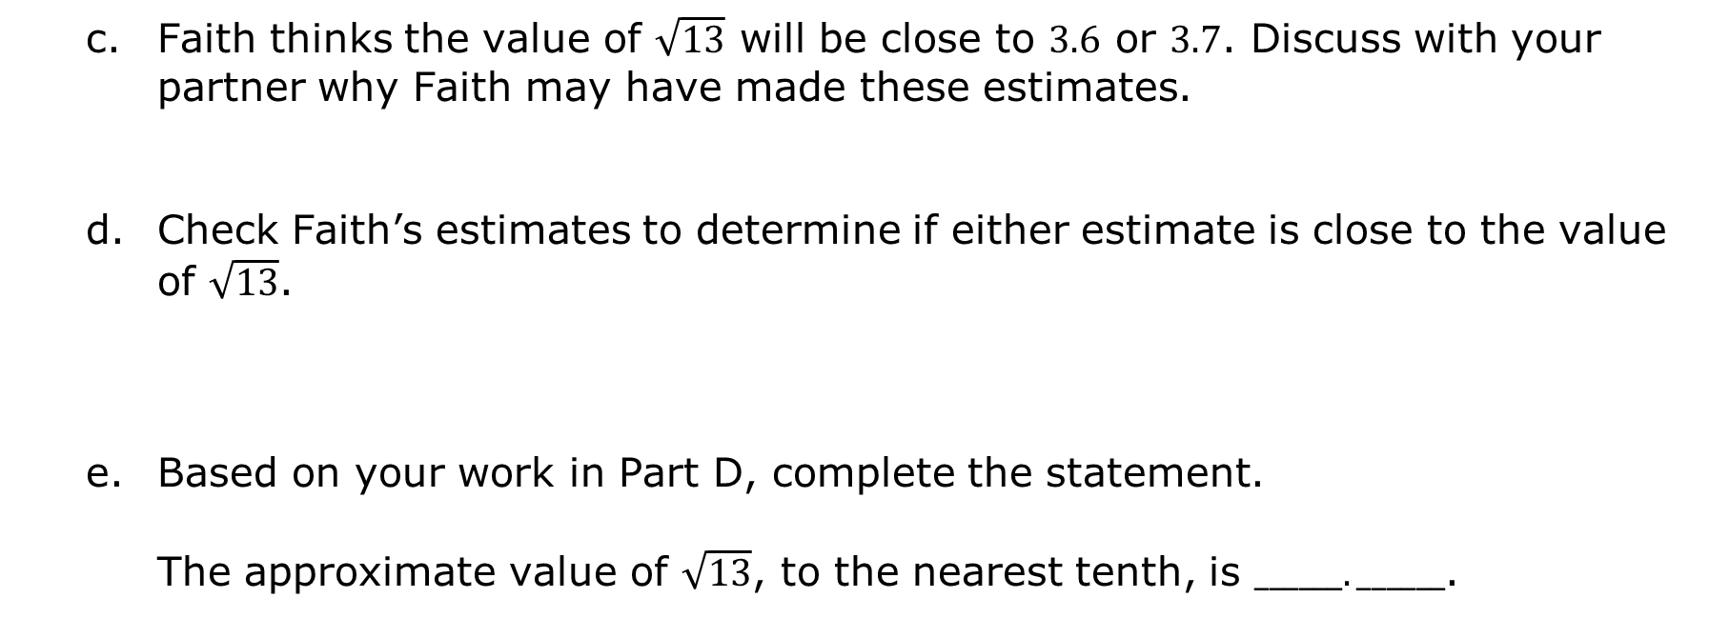
Faith thinks the value of $\sqrt{13}$ will be close to $3.6$ or $3.7$. Discuss with your partner why Faith may have made these estimates.
Check Faith’s estimates to determine if either estimate is close to the value of $\sqrt{13}$.
Based on your work in Part D, complete the statement.
The approximate value of $\sqrt{13}$, to the nearest tenth, is $______. ______$.
volume 1, pg. 66

Slide 23
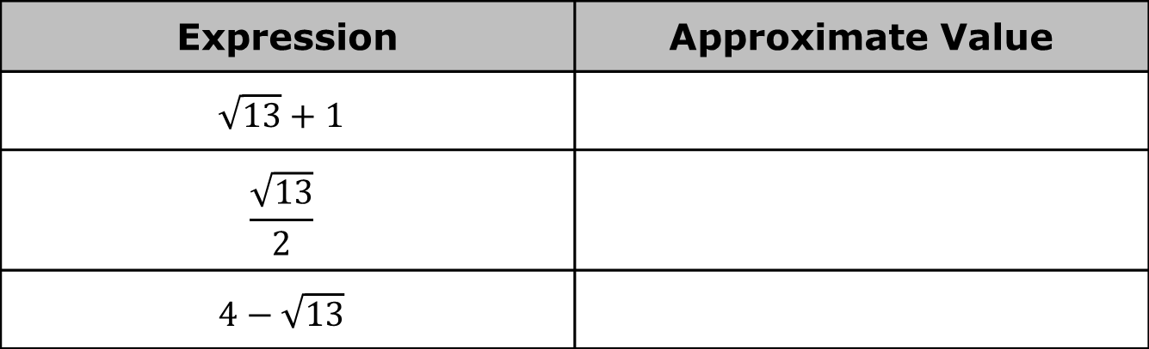
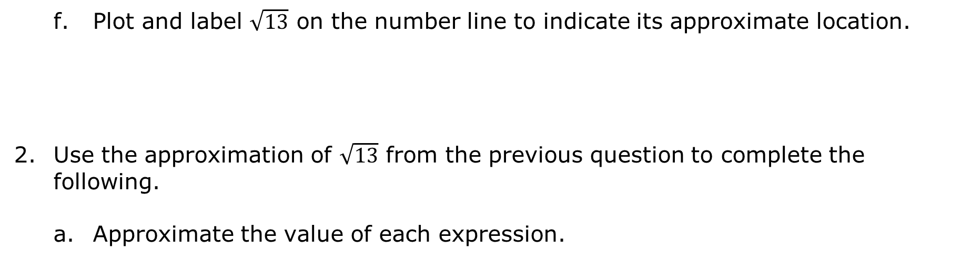
Plot and label $\sqrt{13}$ on the number line to indicate its approximate location.
Use the approximation of $\sqrt{13}$ from the previous question to complete the following.
Approximate the value of each expression.
Expression | Approximate Value
$$\sqrt{13}+1$$
$$\frac{\sqrt{13}}{2}$$
$$4−\sqrt{13}$$
volume 1, pg. 67

Slide 24

Plot and label the approximate location of each expression from part a on the number line.
To approximate the value of expressions involving irrational numbers, first approximate the value of the irrational number. Then, use that approximation to perform any operations indicated.
volume 1, pg. 67

Slide 25

Guided Practice
volume 1, pg. 67

Slide 26

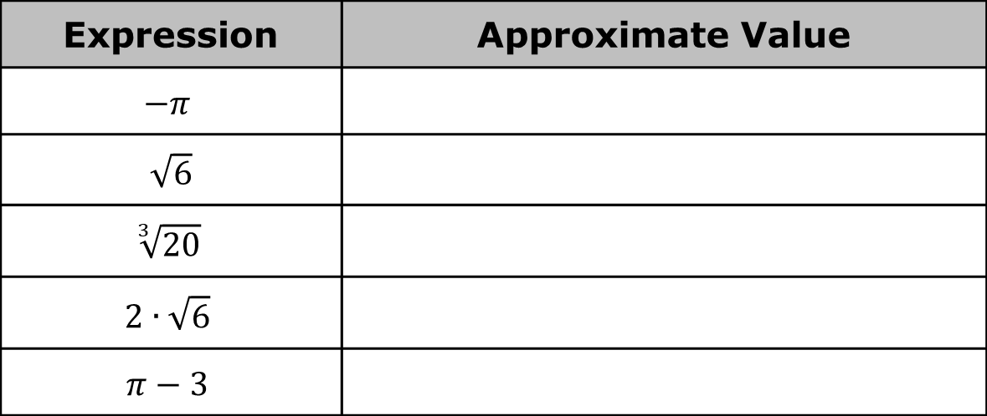
2.5.6 Guided Instruction: Approximating Irrational Numbers and Locating Them on a Number Line
Approximate the value of each expression.
Expression | Approximate Value
$$−π$$
$\sqrt{6}$
$$\sqrt[3]{20}$$
$$2∙\sqrt{6}$$
$$π−3$$
volume 1, pg. 67

Slide 27
Plot and label the approximate location of each expression from the previous question on the number line.
volume 1, pg. 67

Slide 28

Wrap-Up
volume 1, pg. 68

Slide 29
2.5.7 Wrap-Up: Reflection
Complete the table.
The terms and information used in the lesson that I knew were… | Something I wondered during the lesson was… | Something I learned during lesson was…
volume 1, pg. 68

